Slide 1
{California Airports, 2020
https://josh-ko.github.io/final%20project/
(Josh Koepke)
}

Slide 2
Original Dataset {
https://josh-ko.github.io/final%20project/
Data on California public airports in 2020.
Collected and used by the state of California for management purposes.
Contains advanced jargon and leftovers from relational database usage.
Limited functionality as links to individual airport websites no longer work.
}

Slide 3
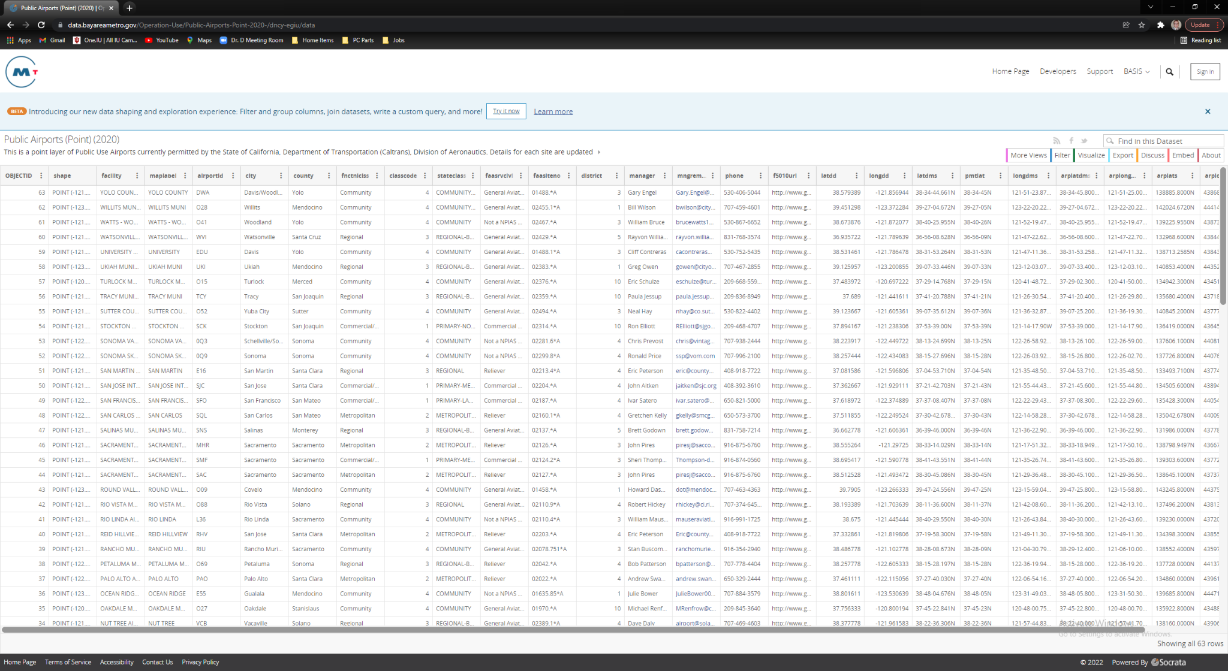
https://josh-ko.github.io/final%20project/

Slide 4
Intended Audience {
https://josh-ko.github.io/final%20project/
Laypeople and common public.
Sky diving lessons
Photographers
Learning to fly
Flight planning logistics
}

Slide 5
Design Changes {
https://josh-ko.github.io/final%20project/
Simplify
Eliminate jargon (e.g., ObjectID, shape)
Condense dataset
Too many longitudinal and latitudinal columns
Restore functionality
Broken website links replaced with Google Maps links
Increase usability
Providing CSS to make table more visually appealing
Google Maps is more convenient for common person than GIS coordinates
}

Slide 6
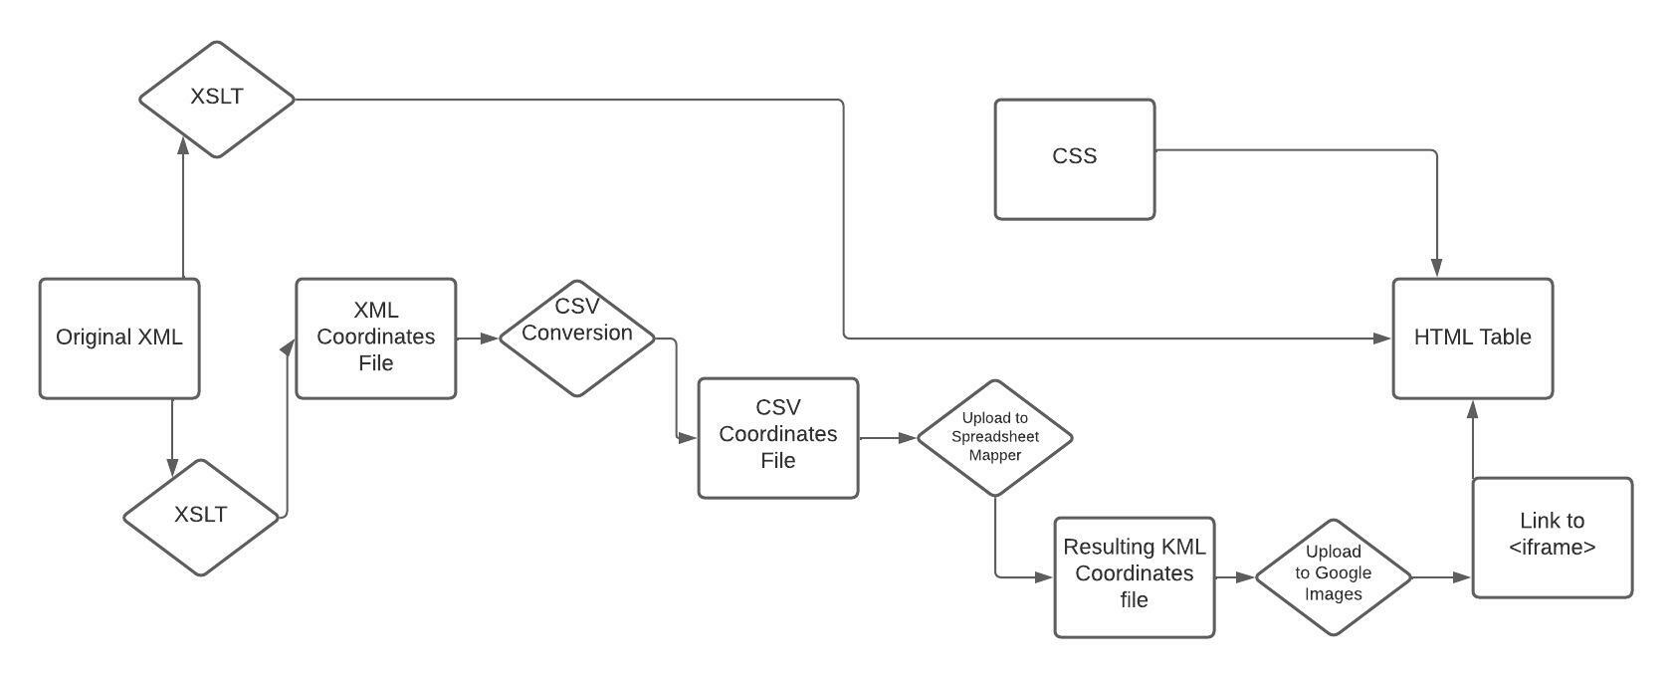
Workflow {
https://josh-ko.github.io/final%20project/
}

Slide 7
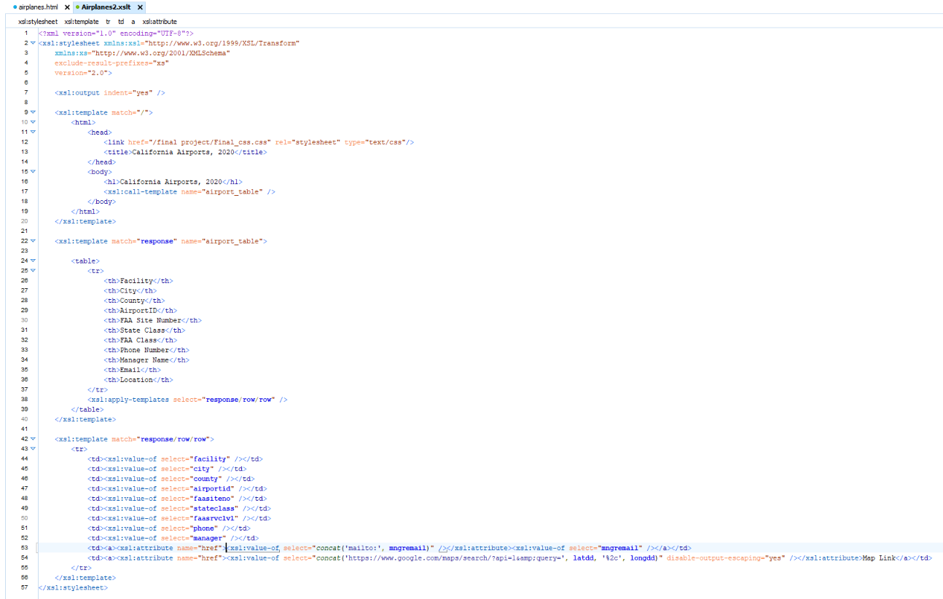
Conversion to HTML
https://josh-ko.github.io/final%20project/
}

Slide 8
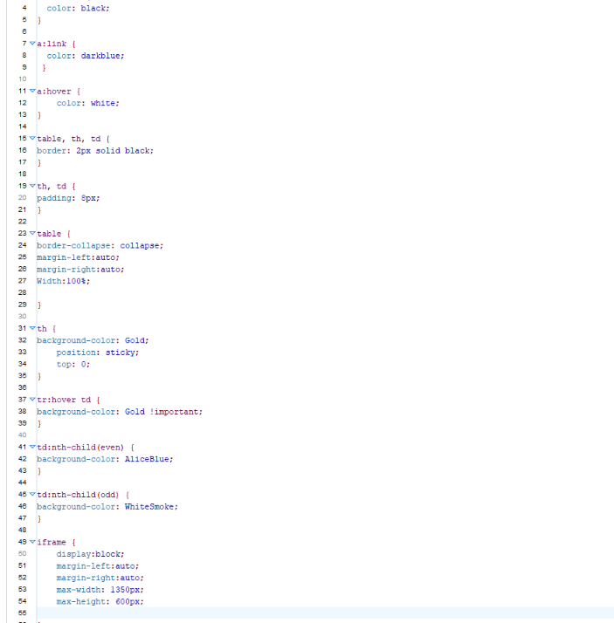
Creation of External CSS {
https://josh-ko.github.io/final%20project/

Slide 9
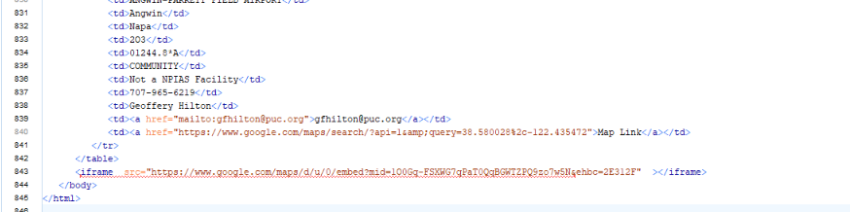
Creation of Embedded Google Maps {
https://josh-ko.github.io/final%20project/
Create XSLT of just airport name, latitude, and longitude entities.
Convert XML output into CSV
Upload CSV to Google Spreadsheet Mapper V3
KML result then uploaded into Google Maps
Incorporate the iframe into your html page
}

Slide 10
Highlights {
https://josh-ko.github.io/final%20project/
Utilized concatenate function with Google Maps and longitude/latitude data to form links.
New CSS makes data easier to digest.
Embedded Google Maps provides visual to data.
https://josh-ko.github.io/final%20project/airplanes.html
}

